Slide 1
Practical Java
Kristof Werling
April 2022

Slide 2
Organizational Info

Slide 3
Each day of the lecture
2 Parts
Part 1:
Learn about new Java concepts and functionality
Easy and short exercises to enhance the understanding of the material
Part 2:
Use the new concepts and functionality of Part 1 to enhance and extend the Converter project

Slide 4
Part 1 – more details
There will be exercises
Each execise comes with a solution
Each exercise will be discussed with the whole group and problems / issues will be addressed
The solution provided also will be discussed

Slide 5
Depth of the information provided
For the most part the information provided is sufficient to work out the solution to the execises
For most of the concepts and functionality shown there is a vast body of knowledge we cannot explore in any kind of practical manner.

Slide 6
Project for this lecture
Project
Converter: Markdown to Latex and later to Html
Simple solution.
Each lecture works on one aspect of the solution (like: GUI, DB, …)

Slide 7
Markdown Tags
Project
Headings | Text Formatting | Rendered Output
# Heading level 1 | **This is bold text** | Link to [Google](https://www.google.com/)
## Heading level 2 | __This is bold text__ | - Unordered List Item 1 - Unordered List Item 2 - Unordered List Item 3
### Heading level 3 | *This text is italicized*
#### Heading level 4 | ~~Strikethrough text~~
##### Heading level 5 | ***Bold and italics text*** | 1. Ordered List Item 1 1. Ordered List Item 2
###### Heading level 6 | **Bold and *nesting italics* text**
Source: https://www.markdownguide.org/basic-syntax
Or
https://docs.github.com/en/get-started/writing-on-github/getting-started-with-writing-and-formatting-on-github/basic-writing-and-formatting-syntax All the gory details (specs): https://github.github.com/gfm/

Slide 8
Latex
Project
Boiler Plate for a Latex Document | \documentclass[12pt, a4paper] {article} \begin{document} Here goes the document. \end{document}
Source: https://www.overleaf.com/learn/latex/Learn_LaTeX_in_30_minutes

Slide 9
Latex
Project
Bold | This is \textbf{bold text}
Italic | This is \textit{text in italic}
Strikethrough
Unordered List | \begin{itemize} \item Item 1 \item ... \end{itemize}
Ordered List | \begin{enumerate} \item Item 1 \item ... \end{enumerate}
Link | Use the hyperref package
Source: https://www.overleaf.com/learn/latex/Learn_LaTeX_in_30_minutes

Slide 10
Latex
Project
Heading 1 | \section{section}
Heading 2 | \subsection{subsection}
Heading 3 | \subsubsection{subsubsection}
Heading 4 | \paragraph{paragraph}
Heading 5 | \subparagraph{subparagraph}
Source: https://www.overleaf.com/learn/latex/Learn_LaTeX_in_30_minutes

Slide 11
What we need to get started
Preparation
IntelliJ Community Edition (Download here)
MiKTex (or any other Tex that can process Latex) (Download here)
OpenJDK Java 18 (Download here)
Markdown Viewer (For example: Windows Markdown Viewer)
Git for Windows (Download here)

Slide 12

Github.Com Account
Preparation
Sign in or Sign up

Slide 13
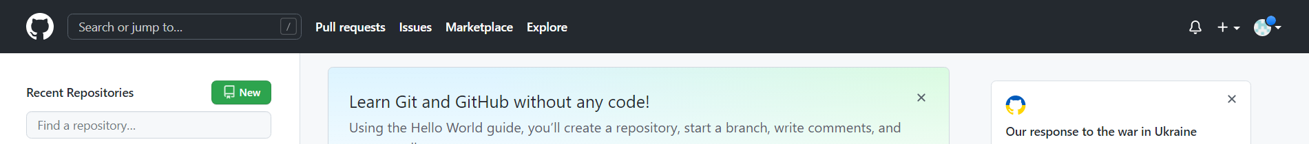
Create new Repository
Preparation
New Repository

Slide 14
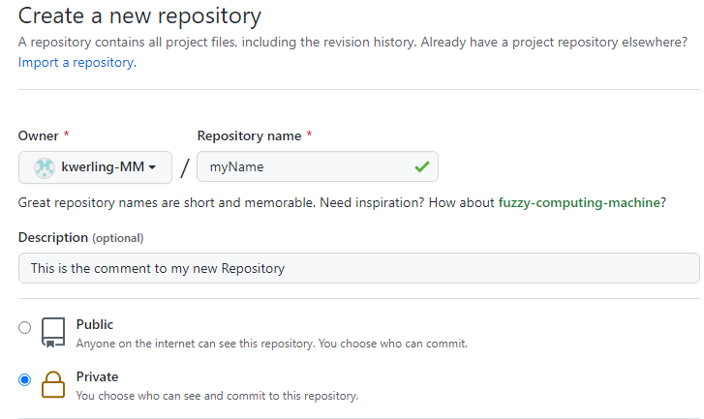
Create new Repository 1 of 2
Preparation
Repository name
Comment, if wished
Private or Public access

Slide 15
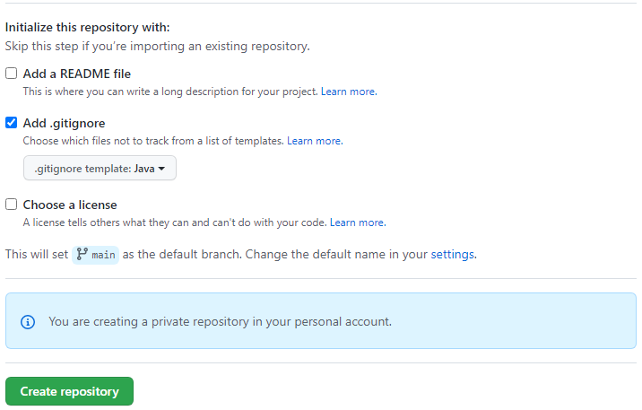
Create new Repository 2 of 2
Preparation
Add .gitignore for JAVA
Create it

Slide 16
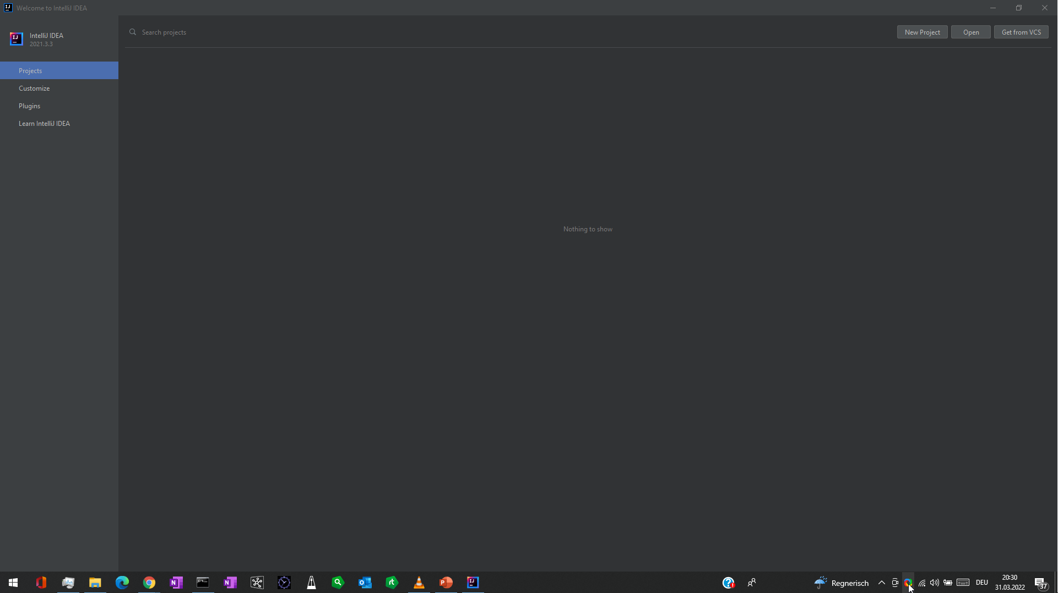
Creating a new project 1 of 5
Preparation
New Project

Slide 17
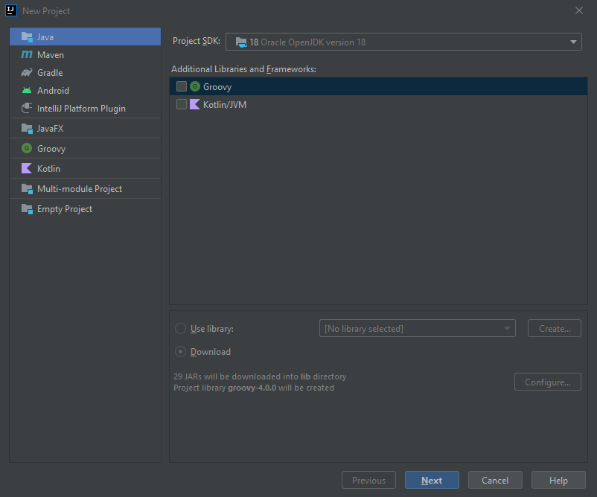
Creating a new project 2 of 5
Preparation
Make sure your JDK is listed here
Java
Press Next

Slide 18
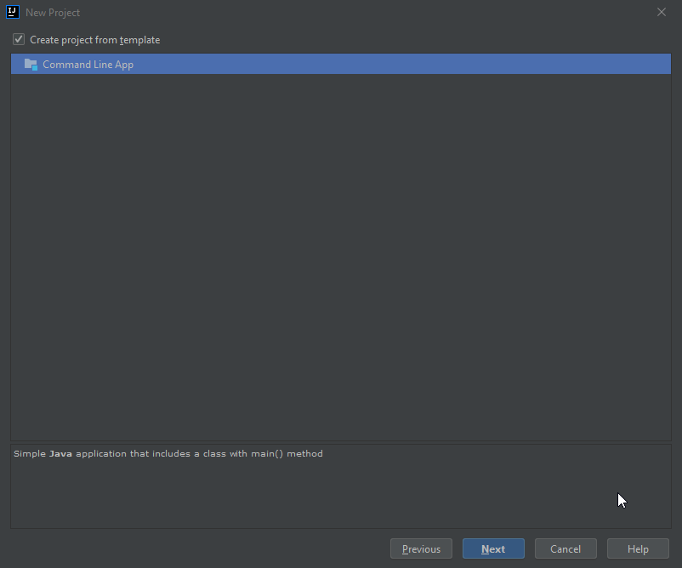
Creating a new project 3 of 5
Preparation
Choose the Commend Line Template to get started
Press Next

Slide 19
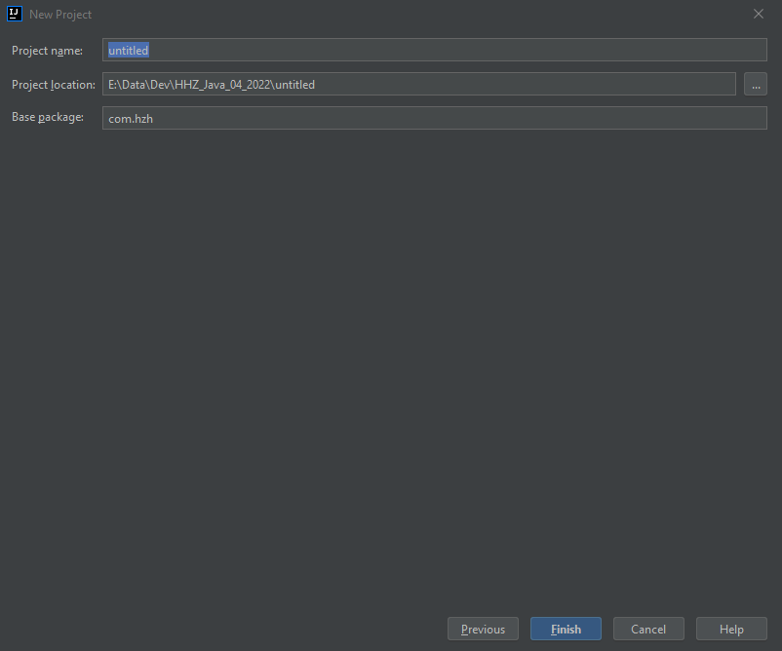
Creating a new project 4 of 5
Preparation
Give it a name
Local directory
Name space
Press Next

Slide 20
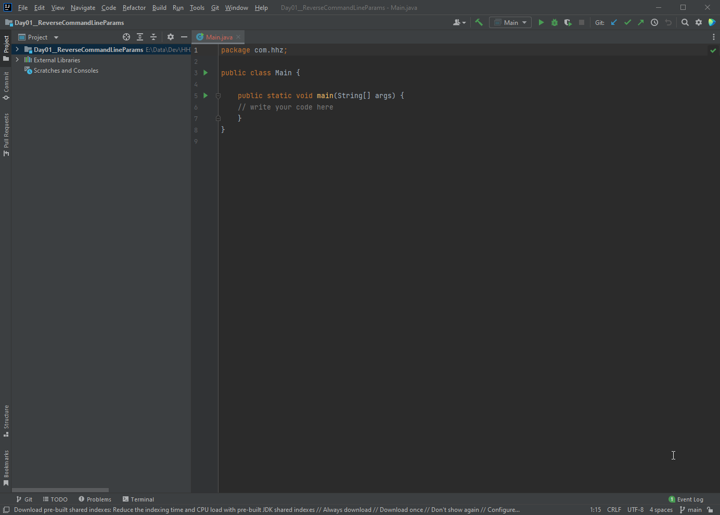
Creating a new project 5 of 5
Preparation
Resulting project

Slide 21
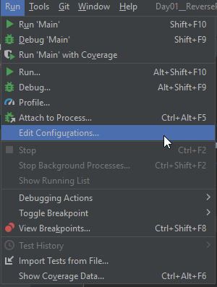
Run with Command Line Params 1 of 2
Preparation
Adjust the configuration

Slide 22
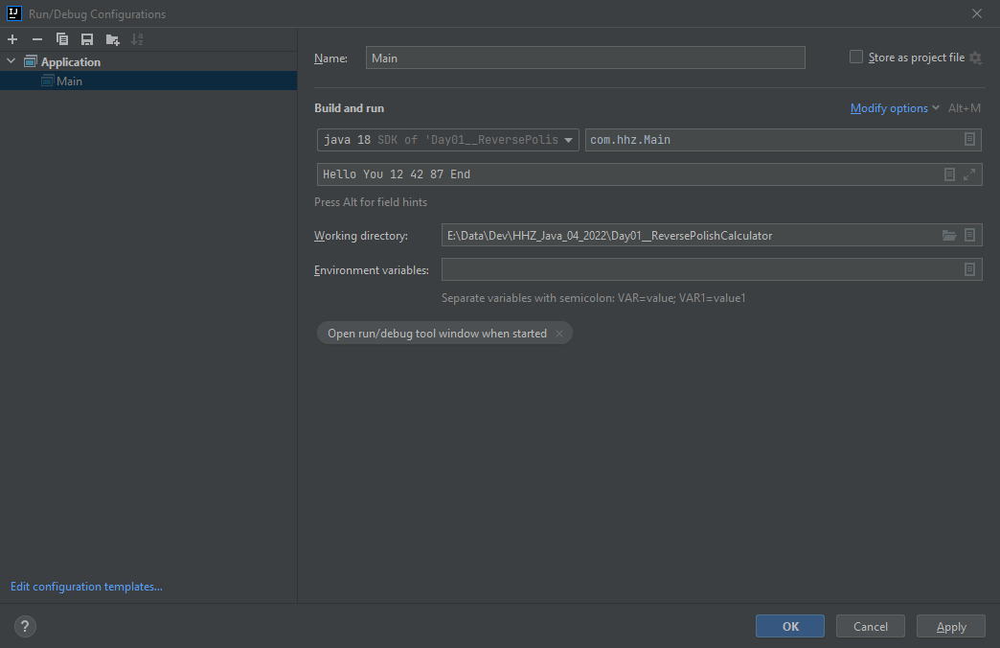
Run with Command Line Params 1 of 2
Preparation
Here go the command
Line params

Slide 23
Table of Content
Project used in the lecture
Day 1: Playing with Java / Deepen the knowledge
Day 2: User Interfaces
Day 3: Networking – From Socket to Message Bus
Day 4: Working with Databases ( SQL and No-SQL )
Day 5: Wrap-Up and Overflow

Slide 24
Command line parameters
Day 1
The main function takes the command line parameters in an String array
Each parameter is passed on as a String (String array after all)
In case of no command line parameters the String array is empty

Slide 25
Exercise 01
Day 1
Write a program, which prints out the command line parameters in reverse order

Slide 26
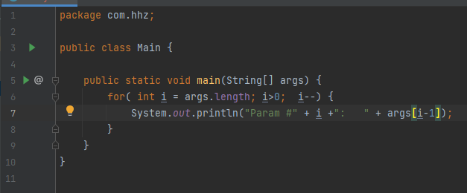
Exercise 01 - Solution
Day 1

Slide 27
Some methods of the String class
Day 1
(some) String class method | Functionality
String toLowerCase() | It returns a string in lowercase.
String toUpperCase() | It returns a string in uppercase.
String trim() | It removes beginning and ending spaces of this string.
int indexOf(String substring) | It returns the specified substring index.
String[] split(String regex) | It returns a split string matching regex.
boolean contains(CharSequence s) | It returns true or false after matching the sequence of char value.
int length() | It returns string length. Compare to Array.length !!
String substring(int beginIndex, int endIndex) | It returns substring for given begin index and end index.

Slide 28
Exercise 02 – Playing with String comparison
Day 1
Take the code on this slide
Run it
Explain the results

Slide 29
Exercise 03 – Playing with String concatination
Day 1
Take the code on this slide
Run it
Explain the results

Slide 30
Integer class – parsing of text
Day 1
int Integer.parseInt( String ) tries to convert the String into an integer value. Throws an exception if that not possible. Ex: Integer. parseInt(„411“) → 411 Integer. parseInt(„Axx“) → Throws exception

Slide 31
Try – catch - finally
Day 1
In order to control code, which might throw exceptions it is enclosed in a try-catch (-finally) construct: try { // Code, which might throw exeptions } catch( Exception ex ) { // Code to run if an exeption happened } finally { // Code, which runs wether an exeption was thrown }

Slide 32
Exercise 04
Day 1
Write a program, which prints out the command line parameters in reverse order.
Add 10 to each integer value in the list before printing it out.

Slide 33
Class Stack
Day 1
Growths ( aka Push operation) upwards
Shrinks (aka Pop operation) downards
There are only the push and pop operations for accessing the stack.
Push 5
5
4
3
Push 4
4
3
Push 3
3

Slide 34
Unit testing
Day 1
Small test of parts of code
Always test one thing and one thing only
Expected to run fast
YES, I know of projects where the code for testing exceeded the code under test.

Slide 35
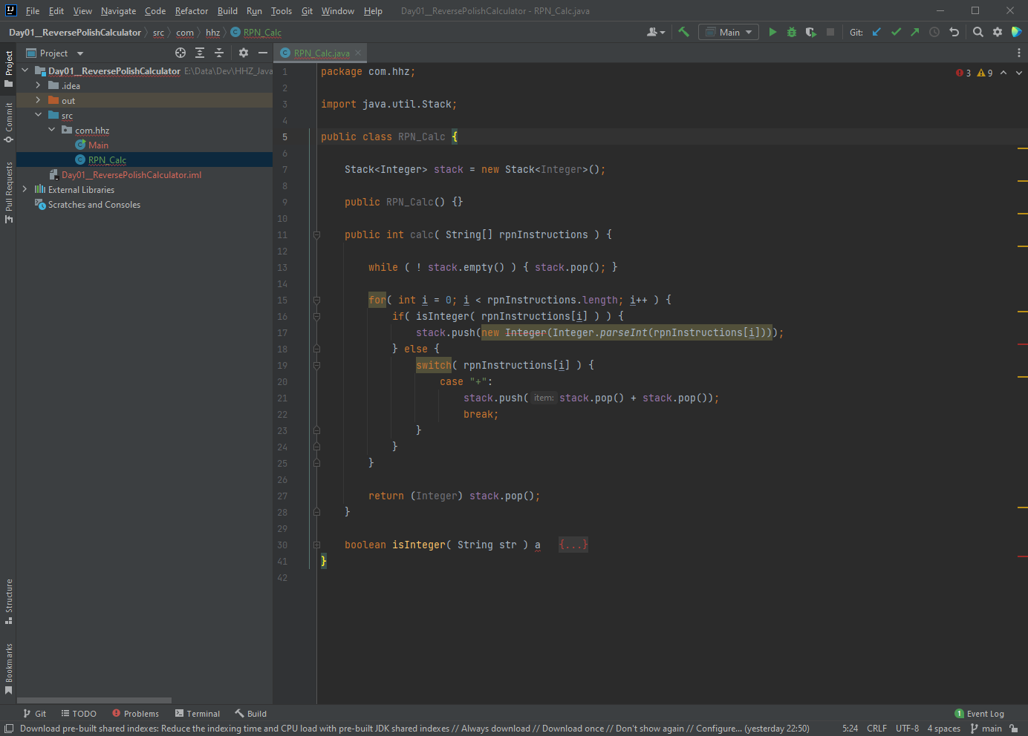
Unit testing
Day 1
In order to create Unit tests move the cursor over the class name and press the right mouse button → context menu

Slide 36
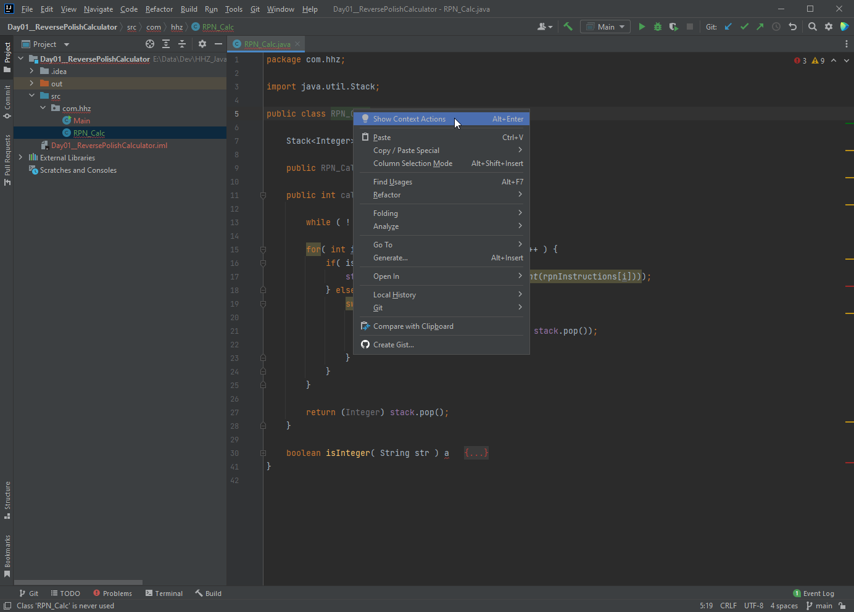
Unit testing
Day 1
Choose „Show Context Action“

Slide 37
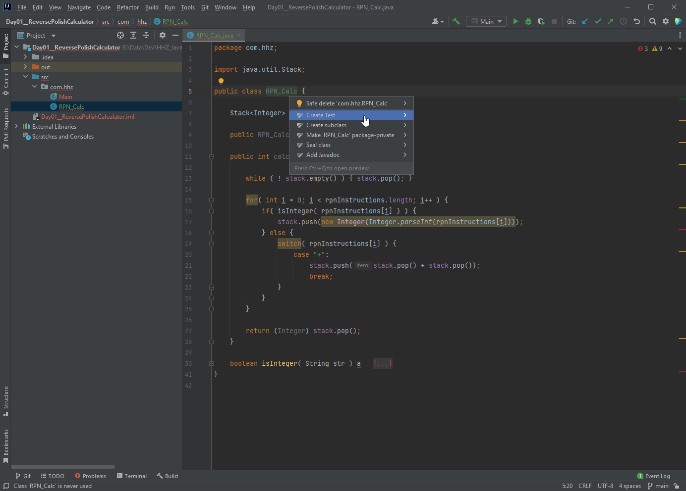
Unit testing
Day 1
Choose „Create Test“

Slide 38
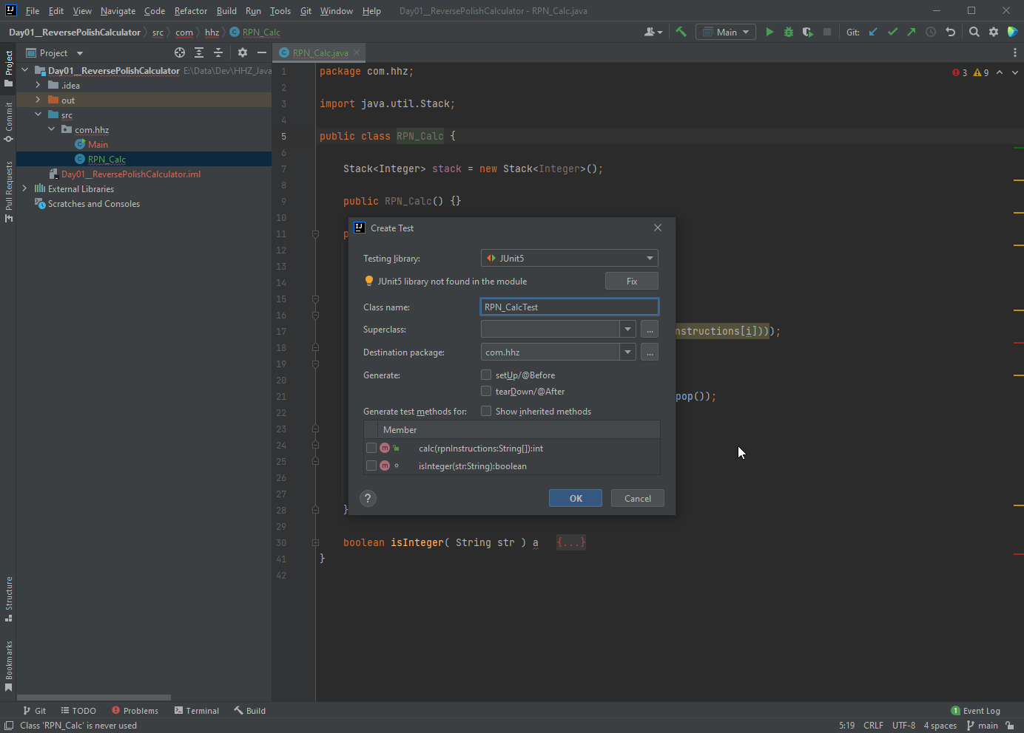
Unit testing
Day 1
When done for the first time the Junit jar file needs to be added to the project. Press „Fix“

Slide 39
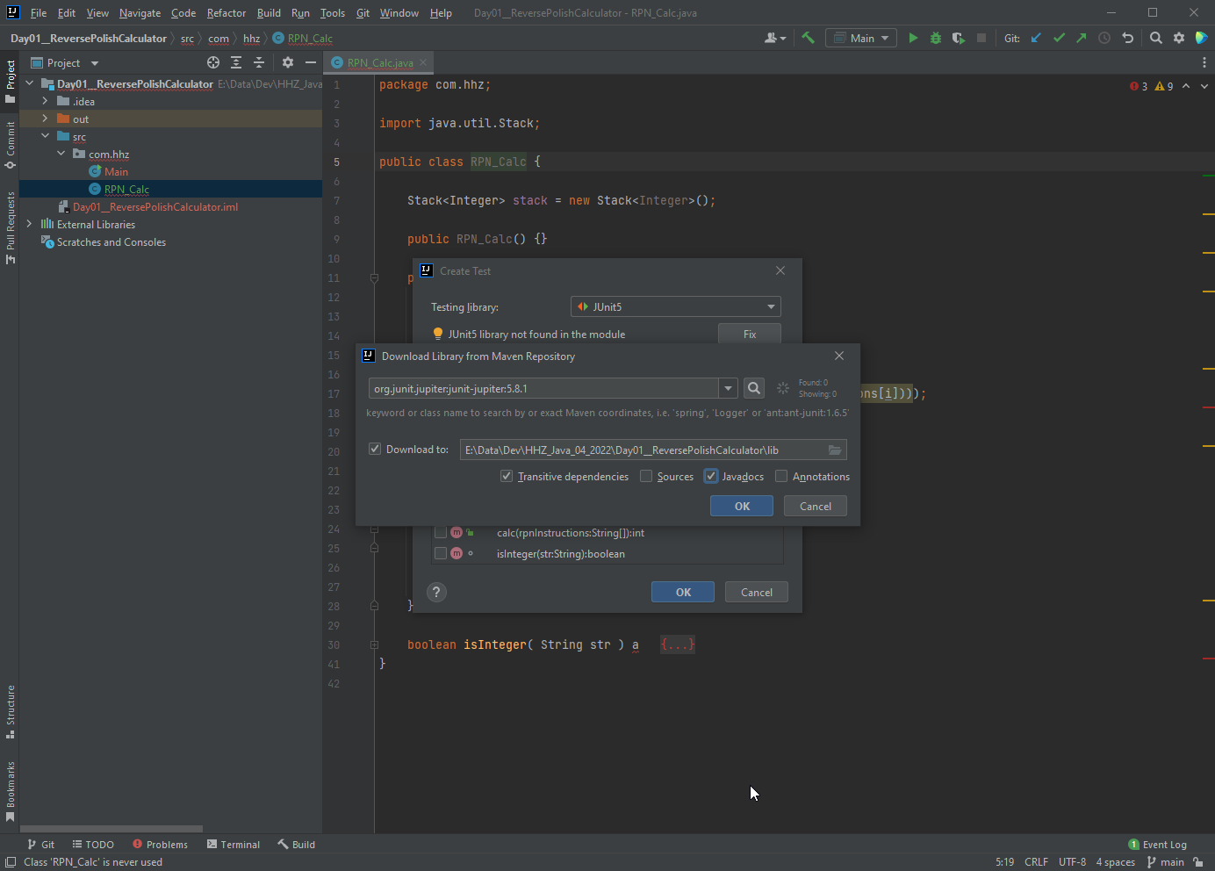
Unit testing
Day 1
Add the Junit jar file Download Javadoc as well.

Slide 40
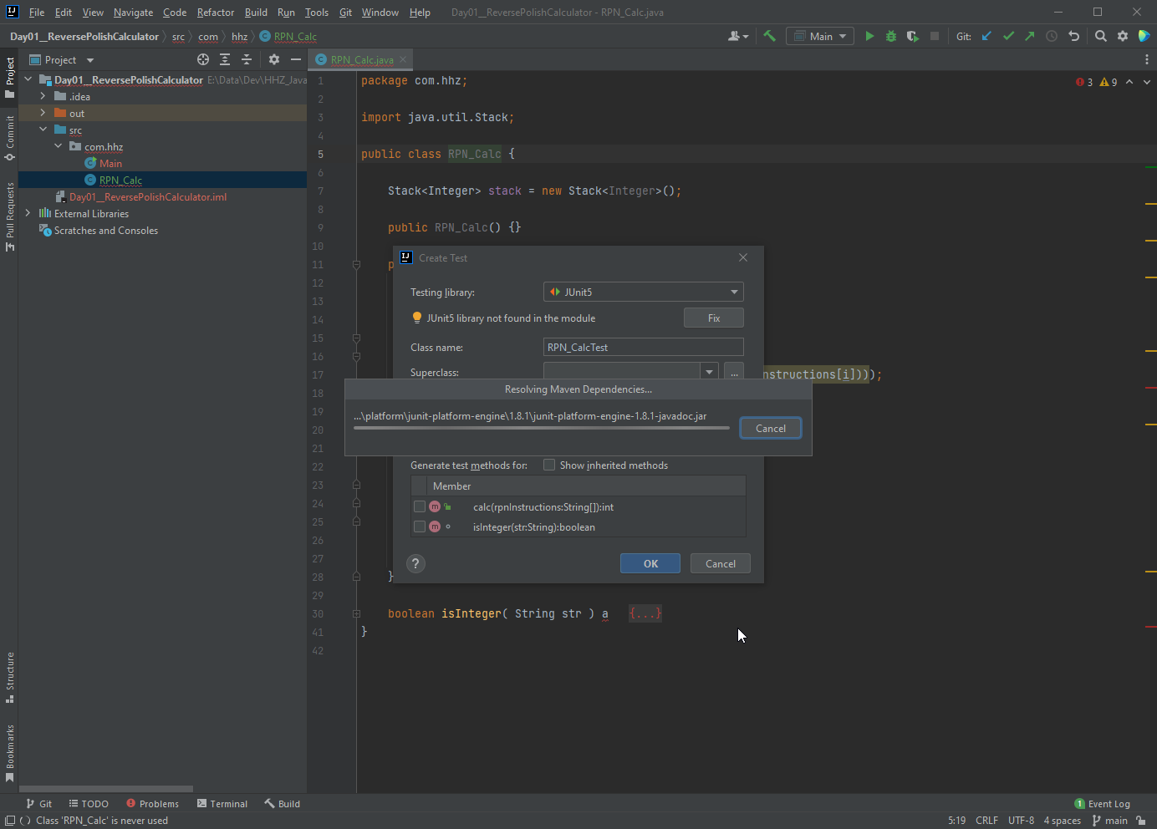
Unit testing
Day 1
IntelliJ downloads the required files

Slide 41
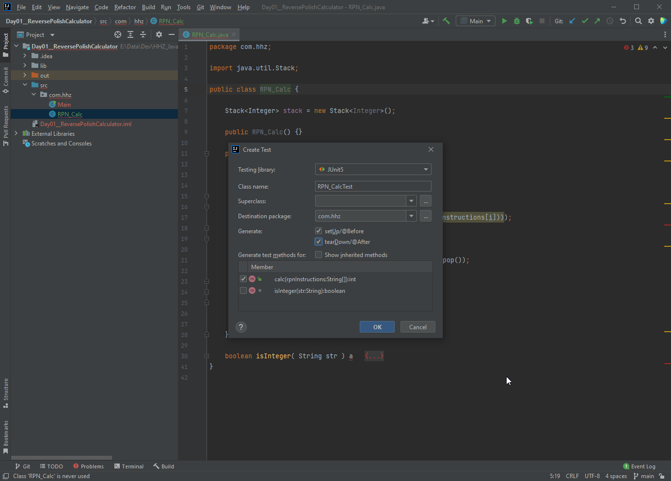
Unit testing
Day 1
Create the Junit test skeleton for the calc method Create the Setup & TearDown methods

Slide 42
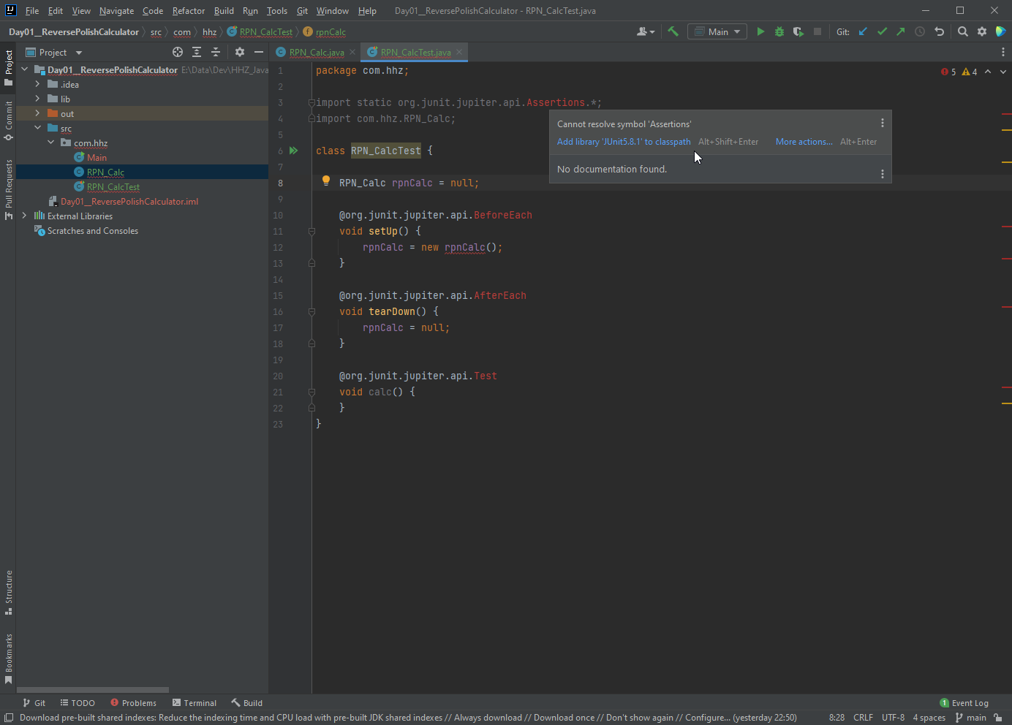
Unit testing
Day 1
Need to add the Junit library to the classpath.

Slide 43
Exercise
Day 1
Create a class Calc
With one method int add( int a, int b), which returns the sum of a and b
Create multiple tests for this method

Slide 44
UPN
Day 1
Add 10 and 20: 10 20 +
3*(4+2) 4 2 + 3 *

Slide 45
Exercise 05
Day 1
Create a class RPN, which has this method:
int calc( String [ ] rpnInstructions );
It takes a string array as input, which contains the operands and the operators in correct order for the calculation
It returns the result of the calculation
Only integer values are used in the calculation
Add Unit testing for verification of the correctness of the class

Slide 46
Exercise Converter
Day 1
Create a Converter class, which is able to take in a text string in Markdown text and convert it into Latex
For starters we need to translate the Headings first
The first character in a line is a ‚#‘,maybe followed by more of them
The first non-‘#‘-character to the end of the line is the Header text
All other text (Markdown tags or not) is simply copied to the Latex file.
Create a Main-method, which takes the Markdown-Filename from the command line.
The Latex file has the same file name as the Markdown file, just ending in ‚.latex‘
Feel free to convert other Makrdown tags as well

Slide 47
Exercise Converter - Hints
Day 1
ArrayList<String>
String class:
charAt
indexOf
substring
trim

